Slide 1
Prospects for health reform and the American Health Care Act (AHCA)
A collection of general slides on what’s next for health reform and the AHCA
First Published: March 30, 2017
Updated: May 10, 2017
Producers: Alexander Perry and Emilia Varrone
Director: Alistair Taylor

Slide 2
Roadmap
HEALTH REFORM AFTER THE AHCA
Looking forward
What’s next for health care?
Politics & policy
Timeline of the AHCA legislative process
Lessons learned from AHCA
How the HHS Secretary can begin to unilaterally dismantle the ACA
Status of the Affordable Care Act
States with only one marketplace insurer
Affordable Care Act approval numbers
Status of AHCA negotiations
How did the House vote on the AHCA?
Which Republicans voted against the AHCA?
Who is on the Senate’s working group to write ACA repeal?

Slide 3
What’s next for health care?
HEALTH CARE: WHAT’S NEXT
Six questions about what is likely to happen this year
Will there be any more serious attempts to replace the ACA?
Maybe. Any serious attempt would likely be a more minor, bipartisan, legislative fix to the ACA
Will Trump’s administration undermine the ACA?
Possibly. However, if Trump’s administration does cause the law to collapse, there will likely be significant political consequences
Will Planned Parenthood be defunded in the government shutdown fight?
Unknown. GOP hardliners in the House will require the provision; however, legislation defunding PP will not pass the Senate
Will CHIP be reauthorized in time? Will UFAs be negotiated in time?
CHIP and other Medicare extenders will probably be passed together with the user fee agreements in a must-pass bill
Sen. Tom Cotton suggested that the reauthorization might be linked to revisitation of ACA – this could prove very difficult and endanger the rest of the package
What about entitlement reform and drug pricing legislation?
Entitlement reform is unlikely to occur in the next two years
Drug pricing legislation is possible, but unlikely in the short term due to a number of other legislative priorities (e.g. tax reform, infrastructure)
Will ACA taxes be repealed through tax reform?
Unlikely – if tax reform is to be passed through budget reconciliation, the legislation must be budget neutral. As the GOP was unable to cut the programs that these taxes fund, they will also be unable to cut the associated taxes
Sources: Billy Wynne and Devin Zatorski, “No Matter What, Congress Will Act On Health Care Next Year,” Health Affairs, November 7, 2016.
March 27, 2017 | Emilia Varrone

Slide 4
Roadmap
HEALTH REFORM AFTER THE AHCA
Looking forward
What’s next for health care?
Politics & policy
Timeline of the AHCA legislative process
Lessons learned from AHCA
How the HHS Secretary can begin to unilaterally dismantle the ACA
Status of the Affordable Care Act
States with only one marketplace insurer
Affordable Care Act approval numbers
Status of AHCA negotiations
How did the House vote on the AHCA?
Which Republicans voted against the AHCA?
Who is on the Senate’s working group to write ACA repeal?

Slide 5
Within about a month, the House GOP’s ACA replacement plan was introduced, withdrawn, amended, and eventually passed
AHCA TIMELINE
Timeline of actions related to the American Health Care Act (AHCA) (1/2)
Mar 6, 2017
AHCA is introduced by House Speaker Paul Ryan and fellow Republicans
Despite lacking a CBO score, AHCA approved by W&M and E&C committees
Release of CBO report: The nonpartisan CBO scores the legislation and predicts that it would cause 24 million people to become uninsured by 2026. Following the release of the report, several moderate House Republicans announced their opposition to the bill
Bill passes Budget Committee: The bill passes the Budget Committee on a 19-17 vote
Manager’s amendment released to tweak the bill: In an attempt to garner more GOP votes, Republicans modified the bill with changes aimed at both hardline conservatives and moderates
Full House vote postponed; willingness to repeal essential health benefits: Leadership pinpointed the 7-year anniversary of the passing of Obamacare as the day for a vote on the AHCA; however, the bill did not have enough support in the chamber to pass. To try to sway members of the House Freedom Caucus, the White House expressed openness to repealing the ACA’s 10 essential health benefits, which alienated some moderate Republicans
House pulls the AHCA: In a sharp rebuke to the ACA replacement plan, Republicans decided not to hold a vote on the proposal after it became clear that negotiations were not bridging the gap between the moderate and hardline conservative holdouts. Speaker of the House Paul Ryan expressed his dismay in a public statement, while the president voiced his intent to move on to other parts of his agenda
Analysis
The House Freedom Caucus, chaired by Rep. Mark Meadows (R-NC), and moderate Republicans were the two factions of the GOP conference that initially killed the bill. The former thought it didn't go far enough in repealing the ACA, while the latter was worried about the political impact of supporting legislation that would cause millions to lose health insurance
The eventual compromise that allowed the AHCA to pass included allowing states to apply for waivers that permit them to opt out of certain ACA insurance requirements and increasing the amount of money for programs that deal with people who have pre-existing conditions
Mar 9, 2017
Mar 13, 2017
Mar 16, 2017
Mar 20, 2017
Mar 23, 2017
Mar 24, 2017
Sources: National Journal research, 2017; David Nather, “Axios Vitals” March 6-24, 2017.
May 5, 2017 | Alexander Perry

Slide 6
MacArthur and Upton amendments revive AHCA negotiations; bill narrowly passes the House
AHCA TIMELINE
Timeline of actions related to the American Health Care Act (AHCA) (2/2)
April 26, 2017
Freedom Caucus comes out in favor of AHCA, with inclusion of MacArthur amendment: Over Easter recess, co-chair of the moderate Tuesday Group, Rep. Tom MacArthur (R-NJ), and chair of the House Freedom Caucus, Rep. Mark Meadows (R-NC), came to an agreement over an amendment that would allow states to waive some of the ACA’s insurance regulations. The agreement specifically targets community rating and essential health benefits
AHCA narrowly passes the House: In a 217-213 vote, the House passed the AHCA. No Democrats supported the measure, while 20 Republicans voted against it. In the days leading up to the successful vote, Rep. Fred Upton (R-MI) introduced an amendment that added $8 billion over five years to bolster the legislation’s coverage for people with pre-existing conditions. The Upton amendment appeared to sway enough moderate Republicans, who were previously concerned about bill’s protection for those with pre-existing conditions
Analysis
The MacArthur amendment swayed the House Freedom Caucus to support the AHCA, while the Upton amendment convinced enough moderate Republicans to pass the measure
The bill will now head to the Senate, where it is likely to be changed significantly
A number of Republicans senators already oppose the measure, for a variety of reasons, including its defunding of Planned Parenthood and potential impact on the opioid epidemic
Given the inevitable changes to the AHCA that will be made in the Senate, it is unclear how different GOP factions in the House might approach a conference committee
May 4, 2017
Sources: National Journal research, 2017
May 5, 2017 | Alexander Perry

Slide 7
Failure of AHCA might be evidence of a degree of political fragmentation that extends to other policy areas
POLITICS OF AHCA
Lessons learned from the legislative process of the AHCA
A unified Republican government, including a GOP president and House majority, could not force enough GOP lawmakers to support the AHCA. What caused this lack of coherence in pursuing a major party initiative?
1
Independence of individual members of Congress
Individual members of Congress have become more willing to act independently of their party’s leadership
4
Polarized sources of money in politics
It is now easier than ever for members of Congress to connect with small donors throughout the country. Small and individual donors tend to be the most ideologically polarized, which further empowers extreme wings of the parties
2
Heightened influence of well-funded outside groups
There has been a transfer of influence from political parties to well-funded outside groups that are willing to support Republican representatives who take stances on issues that align with the group
5
Reduced importance of congressional committee assignments
Committees did not play a central role in crafting the AHCA. Now, committee assignments are less necessary for PR and fundraising purposes, meaning less leverage for leadership
3
Less reliance on party infrastructure
Many members of Congress now depend less on the party’s financial assistance and support. An example of this was the Koch network’s willingness to support those who buck party leadership
6
Impact of elimination of earmarks
The elimination of earmarks has stripped a tool that party leaders could have used to entice members to support certain legislation
Sources: Richard Pildes, “The GOP’s health-care failure is no one-off event. Welcome to our fragmented politics,” Washington Post, March 26, 2017;
March 27, 2017 | Alexander Perry

Slide 8
HHS Secretary Tom Price has many options to unilaterally act on dismantling the Affordable Care Act
TOM PRICE AND DISMANTLING THE ACA
Possible ways for HHS Secretary Tom Price to begin dismantling the ACA:
*This list is not comprehensive and HHS Secretary Tom Price may pursue different courses of action in implementing healthcare reform
1
Stop enforcing the individual mandate:
In coordination with Treasury, Secy. Price could limit collection of the ACA’s penalty for those without health insurance, or stop collecting the penalty altogether
6
Restrict special enrollment periods:
The Trump administration can require people who are trying to sign up outside of the open enrollment period to provide more documentation
2
Tweak hardship waivers:
The HHS secretary has significant leeway to define what constitutes “hardship” when granting exemption to the ACA’s individual mandate penalty
7
Tweak the “like it, keep it” rule
This administrative fix was put in place by the Obama administration in 2013, and allowed people to keep certain non-ACA-compliant insurance plans. Secy. Price can decide whether to end the fix or expand it
3
Limit or eliminate women’s preventive services:
The HHS secretary can exclude contraception from the list of women’s preventive services, or entirely eliminate coverage of women’s preventive services under the law
8
Approve different 1115 waivers for Medicaid
States can propose Medicaid experiments through 1115 waivers — Trump’s CMS will likely approve different Medicaid experiments than the ones approved by Obama’s CMS
4
Expand Hobby Lobby exemption:
Currently, the contraceptive mandate accommodation is available to religious nonprofits and closely-held for profit corporations. Secy. Price can expand this exemption
9
Further delay the Cadillac tax
The Trump administration can choose to delay the tax again in 2020, when it is currently set to go into effect
5
Narrow regulations on essential health benefits:
While the 10 essential benefit categories are codified in the law, Price can issue regulations that would permit insurers to more narrowly define what it means to cover the categories
10
Adjust parameters for 1332 waivers
These waivers permit states to adopt innovative structures for health insurance, as long as the coverage retains the basic protections of the ACA
Sources: Sarah Kliff, “Today in Obamacare: 17 ways Tom Price can start dismantling the ACA,” Vox, February 10, 2017; Nicholas Bagley and Adrianna McIntyre, “Executive actions Trump could take to change the ACA,” The Incidental Economist, January 23, 2017.
February 13, 2017 | Alexander Perry

Slide 9
Roadmap
HEALTH REFORM AFTER THE AHCA
Looking forward
What’s next for health care?
Politics & policy
Timeline of the AHCA legislative process
Lessons learned from AHCA
How the HHS Secretary can begin to unilaterally dismantle the ACA
Status of the Affordable Care Act
States with only one marketplace insurer
Affordable Care Act approval numbers
Status of AHCA negotiations
How did the House vote on the AHCA?
Which Republicans voted against the AHCA?
Who is on the Senate’s working group to write ACA repeal?

Slide 10
Analysis Finds that in 2017, Seven States Will Have Only One Carrier Per ACA Exchange Market Rating Region
ACA EXCHANGE COMPETITION
States with ACA exchanges markets facing limited competition
■ States with only one insurer in their ACA markets
WA
MT
ND
ME
Analysis
Rating regions are the geographic areas used to set insurance premiums.
Avalere found that in 2017, seven states – AK, AL, KS, NC, OK, SC and WY – will have only one insurer in each of their ACA markets.
OR
MN
ID
SD
WI
NY
WY
MI
NV
NE
IA
PA
UT
IL
IN
OH
WV
CA
CO
KS
MO
VA
KY
TN
NC
AZ
NM
OK
AR
SC
MS
AL
GA
AK
TX
LA
FL
Sources: Dan Mendelson, “Experts Predict Sharp Decline in Competition Across the ACA Exchanges,” Avalere Health, August 19, 2016.
August 24, 2016 | Alexander Perry

Slide 11
Affordable Care Act’s approval numbers spike amidst GOP’s attempts to repeal the law
ACA FAVORABILITY NUMBERS
Kaiser Family Foundation Health Tracking Poll: ACA Favorability
Sources: KFF Health Tracking Poll, April 2017.
April 27, 2017 | Alexander Perry

Slide 12
Roadmap
HEALTH REFORM AFTER THE AHCA
Looking forward
What’s next for health care?
Politics & policy
Timeline of the AHCA legislative process
Lessons learned from AHCA
How the HHS Secretary can begin to unilaterally dismantle the ACA
Status of the Affordable Care Act
States with only one marketplace insurer
Affordable Care Act approval numbers
Status of AHCA negotiations
How did the House vote on the AHCA?
Which Republicans voted against the AHCA?
Who is on the Senate’s working group to write ACA repeal?

Slide 13
House passes AHCA along party lines with 20 Republican defections
HOUSE VOTE ON AHCA
How the House voted on the AHCA
H.R. 1628: American Health Care Act of 2017
“
A lot of us have been waiting seven years to cast this vote. Many of us are here because we pledged to cast this very vote.”
– House Speaker Paul Ryan (R-WI)
Analysis
After two very public stumbles, the House passed the AHCA due to amendments from Rep. Tom MacArthur (R-NJ) and Rep. Fred Upton (R-MI)
The bill passed along party lines – with only one extra vote to spare. There are four vacancies in the House
The bill will face an uphill battle in the Senate, due in part to political considerations and reconciliation rules. The Senate’s Byrd rule prevents the upper chamber from passing policy provisions that do not significantly affect the budget
216 Votes Needed to Pass
 | Yea | Nay | Not Voting
Republicans | 217 | 20 | 1
Democrats | 0 | 193 | 0
Total | 217 | 213 | 1
Sources: National Journal Research, 2017.
May 4, 2017 | Emilia Varrone

Slide 14
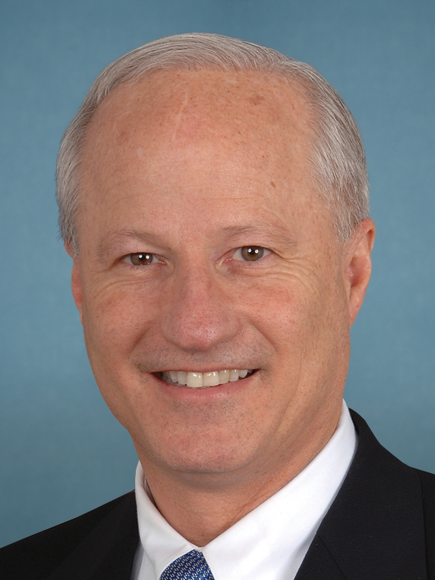
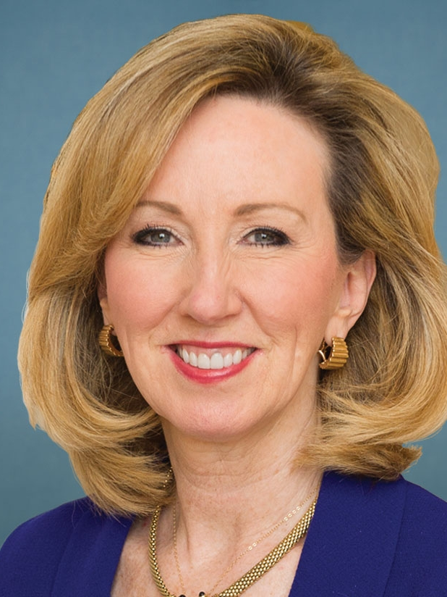
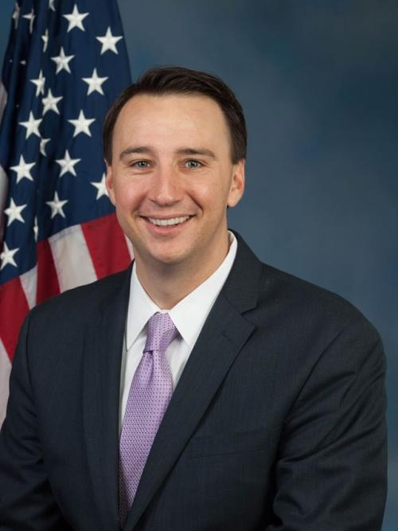
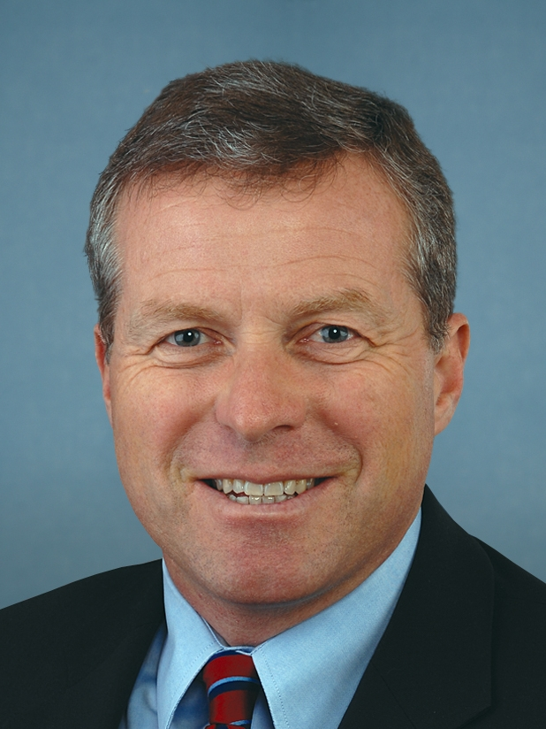
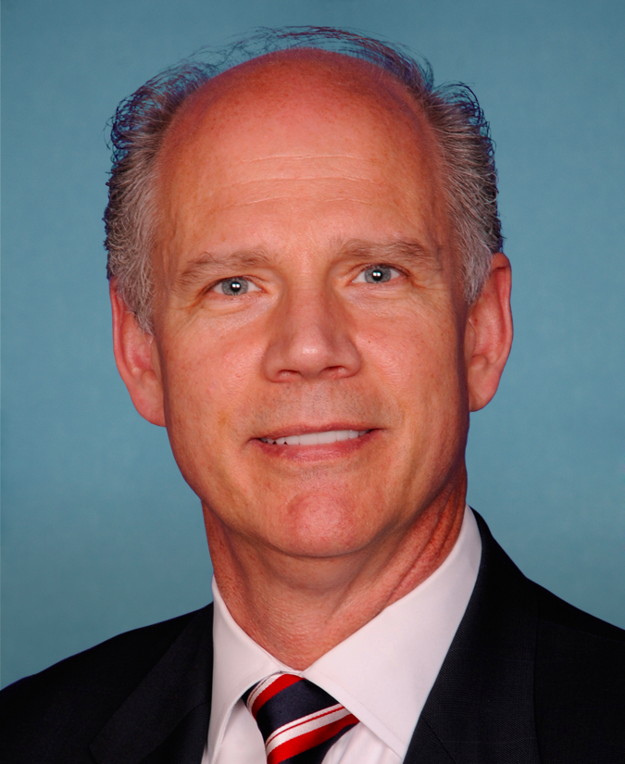
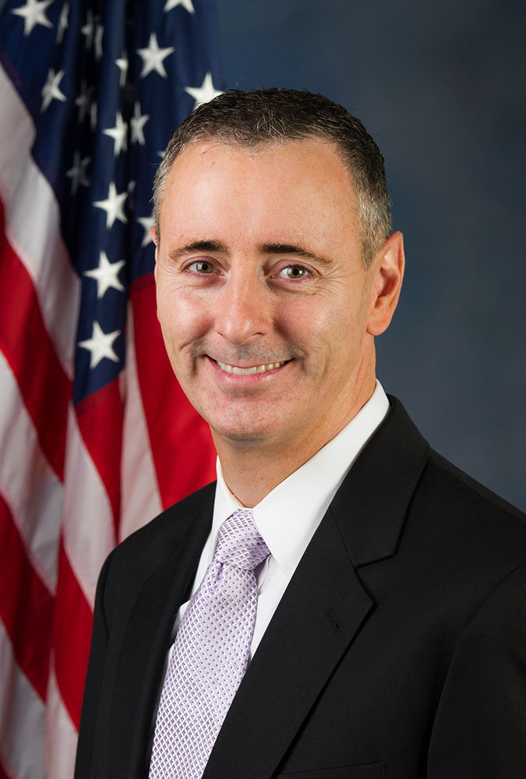
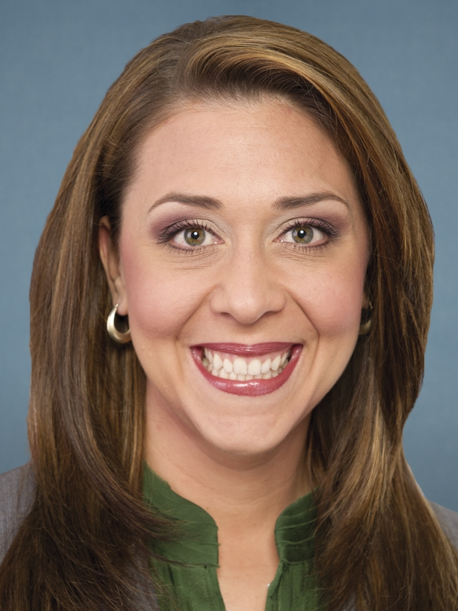
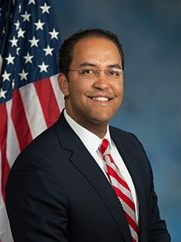
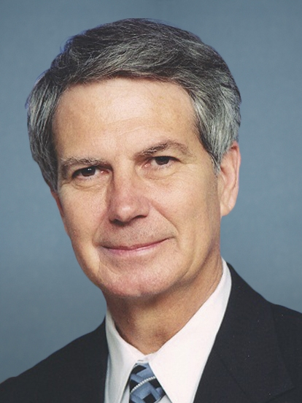
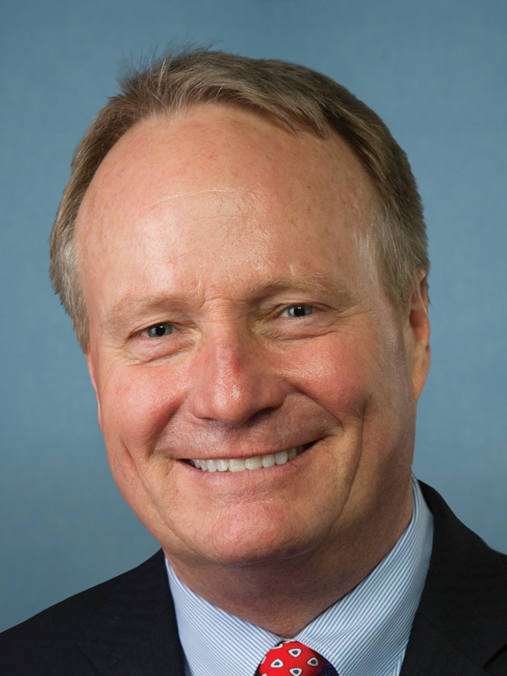
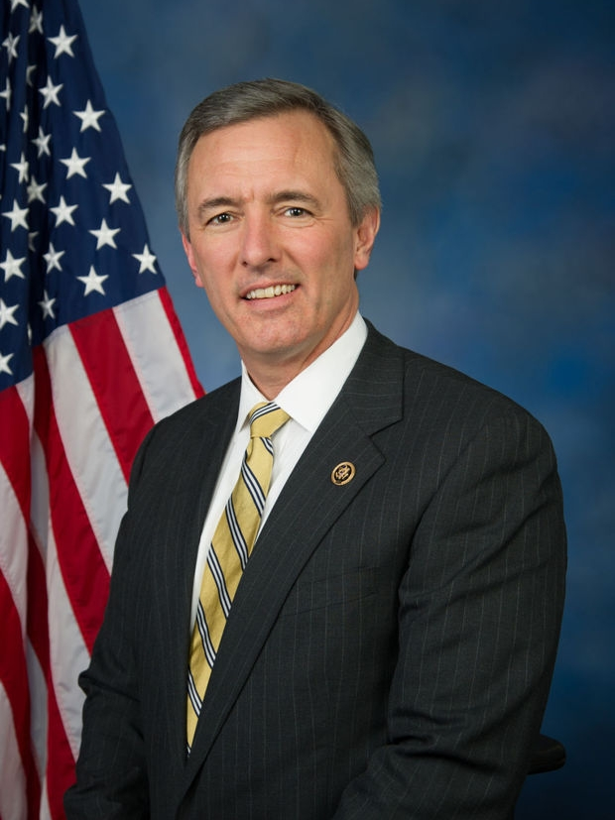
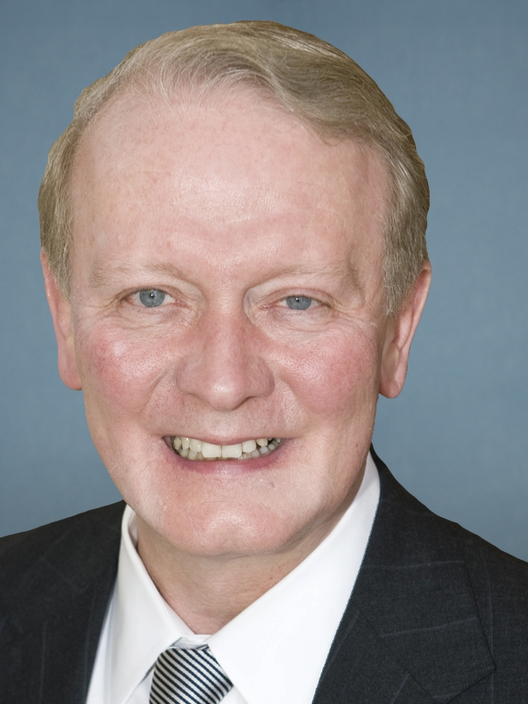
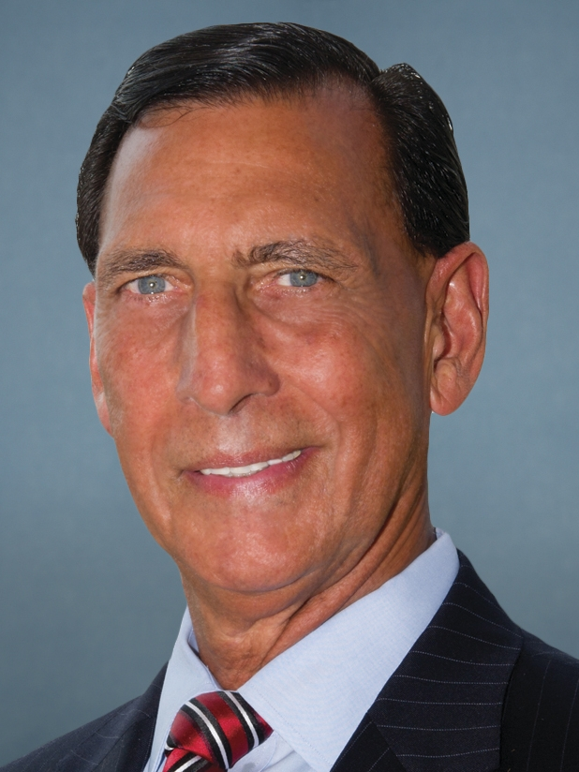
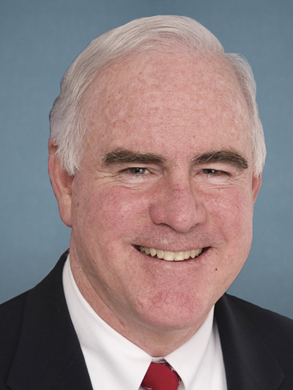
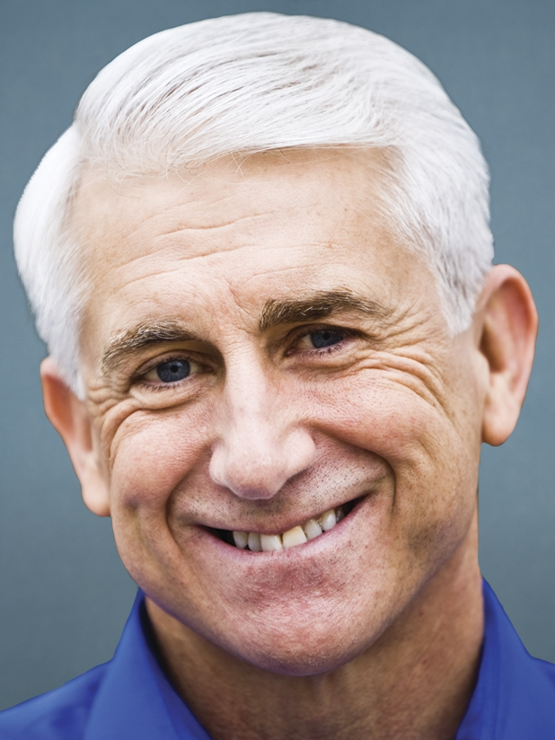
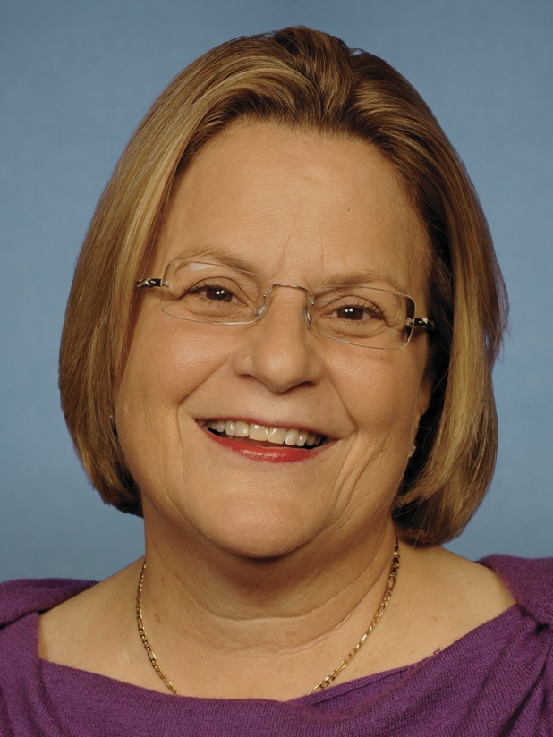
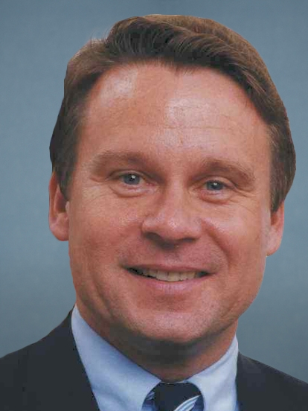
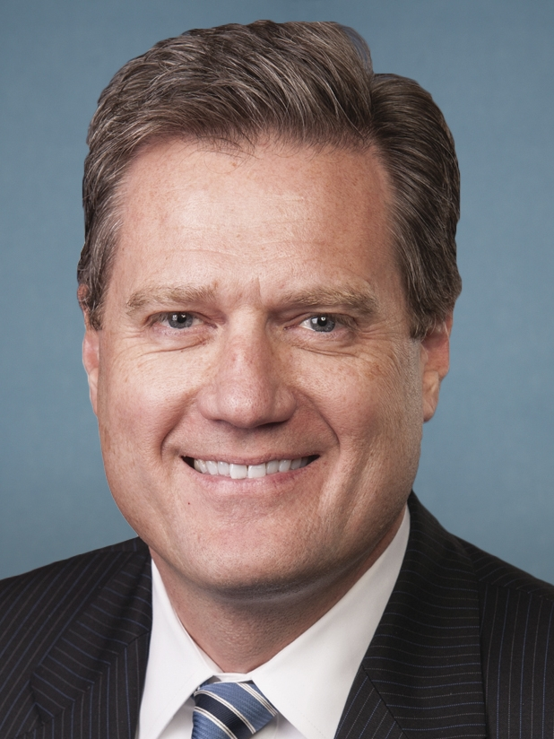
Which Republicans voted against the AHCA?
AHCA PASSES THE HOUSE
List of 20 Republicans who voted against the AHCA
Rep. Andy Biggs
(AZ-5)
Rep. Mike Coffman
(CO-6)
Rep. Barbara Comstock
(VA-10)
Rep. Ryan Costello
(PA-6)
Rep. Charlie Dent
(PA-15)
Rep. Daniel Donovan
(NY-11)
Rep. Brian Fitzpatrick
(PA-8)
Rep. Jaime Herrera
Beutler(WA-3)
Rep. Will Hurd
(TX-23)
Rep. Walter Jones
(NC-3)
Rep. Dave Joyce
(OH-14)
Rep. John Katko
(NY-24)
Rep. Leonard Lance
(NJ-7)
Rep. Frank LoBiondo
(NJ-2)
Rep. Thomas Massie
(KY-4)
Rep. Patrick Meehan
(PA-7)
Rep. Dave Reichart
(WA-8)
Rep. Ileana Ros-
Lehtinen (FL-27)
Rep. Chris Smith
(NJ-4)
Rep. Michael Turner
(OH-10)
Sources: National Journal Almanac, 2017; Chris Cilliza, “20 Republicans voted against the health care bill. Here's why” CNN, May 4, 2017.
May 5, 2017 | Alexander Perry

Slide 15
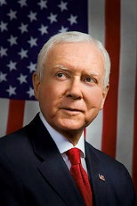
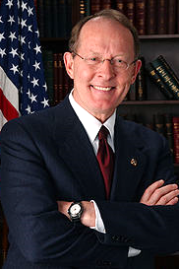
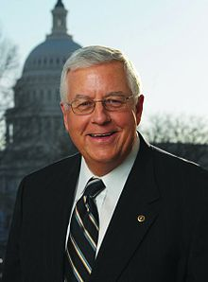
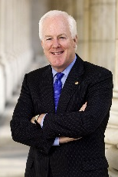
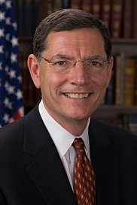
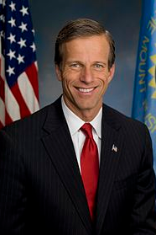
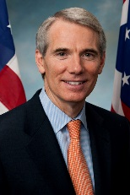
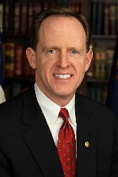
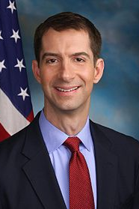
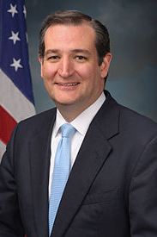
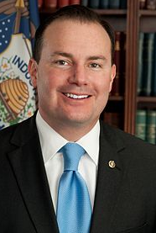
McConnell convenes health reform working group to write ACA replacement
SENATE WORKING GROUP ON HEALTH CARE REFORM
Senate working group on health care reform
Senate Finance Committee Chair
Orrin Hatch
(R-UT)
Senate HELP Committee Chair
Lamar Alexander
(R-TN)
Senate Budget Committee Chair
Mike Enzi
(R-WY)
Senate
Majority Whip
John Cornyn
(R-TX)
Republican Policy Committee Chair
John Barrasso
(R-WY)
Senate Republican Conference Chair
John Thune
(R-SD)
Rob Portman
(R-OH)
Cory Gardner
(R-CO)
Pat Toomey
(R-PA)
Tom Cotton
(R-AR)
Ted Cruz
(R-TX)
Mike Lee
(R-UT)
Sources: National Journal Research, 2017; Joe Williams, “The Senate’s Key Health Care Players,” CQ Roll Call, May 4, 2017, Susan Ferrechio, “Senate won’t vote on House-passed health care bill,” Washington Examiner, May 4, 2017.
May 5, 2017 | Emilia Varrone

