Slide 1
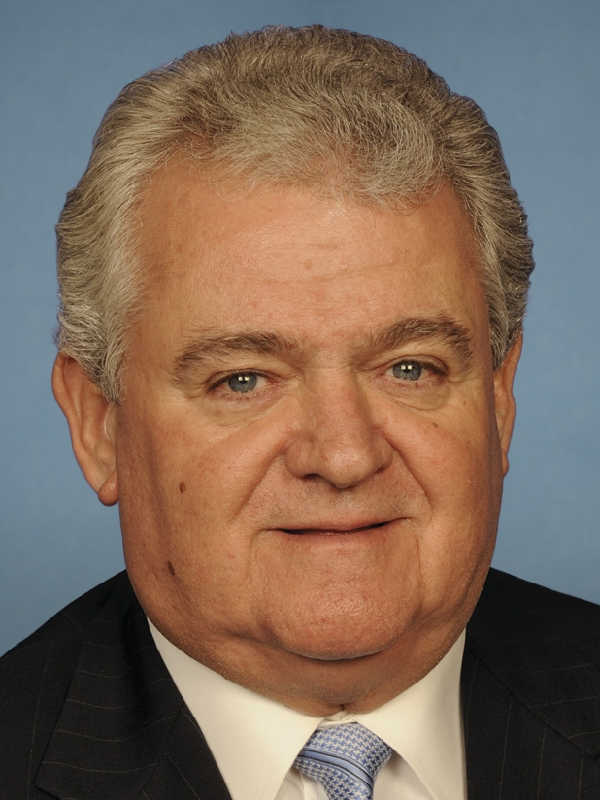
Rep. Robert Brady (D-PA-1)
Background
Democrat Robert Brady, elected in 1998, is the personification of Philadelphia’s old-fashioned urban politics, and is one of the few remaining white ethnic party bosses in big-city America. He depicts himself as a roll-up-your-sleeves guy who represents working-class voters, and says he’s proud to be the boss of what he calls the nation’s largest big-city machine, referring to his chairmanship of the Philadelphia Democratic Party, which he has held since 1986. Brady has a liberal voting record and keeps a low profile in Washington. For “the most powerful man in Philadelphia,” Philadelphia magazine once wrote, “Washington gas-bagging is not his thing.” He boasts of once refusing to take a phone call from President Bill Clinton because he was busy dealing with a woman asking if he could send someone to fix her toilet. His loyalty to unions led him to buck environmentalists and most Democrats to vote for drilling in the Arctic National Wildlife Refuge.
Committees
Armed Services House Administration
Biography
First Elected: 1998
Education: St. Thomas More H.S.
Religion: Roman Catholic
Family: Marital Status: Married, Spouse: Debra, 2 children
Contact Info: RHOB- Rayburn House Office Building, 50 Independence Avenue, SW, Room 2004, Washington, DC, 20515-3801 (202) 225-4731
Election Results
2016 General
Robert Brady (D) | 245,791 | 82%
Deborah Williams (R) | 53,219 | 18%
Online Info
http://www.facebook.com/RepRobertBrady
http://instagram.com/repbrady
Sources: National Journal Almanac, 2018
Slide updated: August 24, 2018

