Slide 1
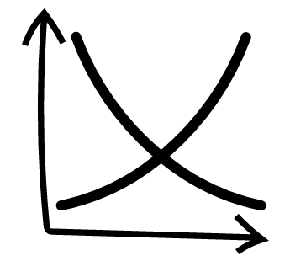
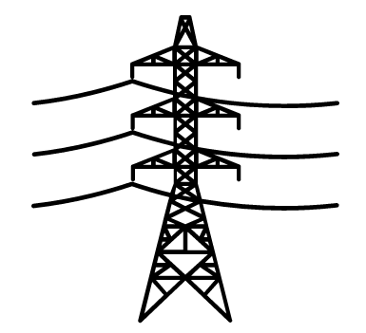
National Academy of Sciences analyzes the effects of climate change on the U.S. electrical grid
CLIMATE CHANGE & THE GRID
Trends in energy demand
The nation’s electrical systems operators are already seeing the effects from climate change and are preparing for the future.
As average temperatures rise, grid operators are reexamining their capacity to meet higher power demand and sharper spikes.
Demand is likely to increase in southwestern and southeastern states, as well as Texas. Northwestern states could see a load decrease.
NAS predicts that by 2100, the average electricity demand will rise by 2.8% across the U.S., and during peak summer months the average is expected to rise by 3.5%.
Peak loads would become more common even without changes in population or income. Texas would likely see 65 days a year with a peak load at or above its current four highest load days.
“
The best way to deal with climate change is to prevent it. There will likely be enormous stresses on the electrical system. A resilient, flexible and fully integrated grid is a good bet long term.”
-- James Hoecker, former chairman of FERC
Co-optimization
NAS recommends that grid operators focus on co-optimization, or adapting generation and transmission plans at the same time, in order to identify the best uses of renewables, demand responses, distributed generation and energy storage.
On a national scale, co-optimization could reduce total generation and transmission costs by 10% (compared to generation-only planning).
Co-optimization would need an incremental transmission investment of $60 billion, but would save $150 billion within 40 years compared to a plan that would focus on boosting generation before improving transmission.
More extreme scenarios
NAS also put forward more extreme scenarios with the demand at 7.2% to 18% higher than current levels.
Extreme scenarios also saw peak loads at 153% to 289% of current peaks.
An increase in peak load of 7.2% would require investing $70 billion in new generation capacity.
An 18% increase would require investment of $180 billion.
The study planned for historical patterns and forecasts of population growth and GDP increases. In reality, grid operators need to also keep in mind unpredictable shocks like superstorms.
Uncertainties in the system are increasing, and it is often customers who pay the costs due to shocks.
Looking forward
If the Trump administration keeps its promise of allocating $100 million from its infrastructure plan for transmission, this could be a big opportunity for utility planners to think about grid modernization.
Spikes in demand for air conditioning could lead to better, more efficient air conditioning technology or battery storage.
Sources: Herman K. Trabish, “How climate change will stress the grid and what ISOs are doing about it, “ Utility Dive, March 6, 2017.
March 6, 2017 | Claire Garney

