Slide 1
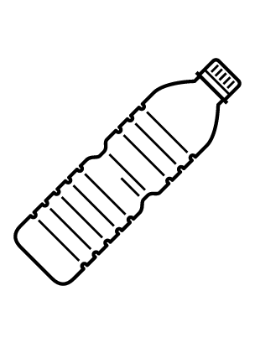
Lead levels in Flint’s water system fall
FLINT WATER UPDATE
Environmental officials announced that lead levels in Flint’s water system no longer exceed the federal limit
The federal “action level” on the amount of lead in the water supply is 15 parts per billion. From January to June 2016, Flint’s level of lead concentrations were 20 ppb, in the second half of the year this fell to 12 ppb.
Despite the announcement, it is still recommended that residents use filters and bottled water because the ongoing replacement of pipes could lead to increased levels in individual homes.
With new data on levels, attorneys are debating if the injunction that the state provide water to residents should be lifted. U.S. District Judge David Lawson will not drop the order until the lead level is below the limit in the next monitoring period.
Now, Flint’s levels are comparable to similarly-sized American cities with older infrastructure.
The level of lead fell in part to increased monitoring of the water system, and partnerships at the local, county, state and federal levels.
Flint needs to continue to replace at least 7% of its lead water lines by June 30, 2017—a project for which Michigan has set aside $27 million.
Flint water crisis timeline
April 2014
Oct. 2015
Jan. – Dec. 2016
Jan. 24, 2017
March 2017
Crisis starts; Flint begins paying part of citizens’ water bills
Flint rejoins Detroit-area water system, cost covered by Michigan
Lead levels in Flint fall from 20 ppb to 12 ppb
Officials announce lead levels below federal limit
Michigan will stop paying for Flint to be on Detroit-area water system
Sources: David Eggert, “Water lead-level falls below federal limit in Flint,” Associated Press, January 24, 2017.
January 25, 2017 | Claire Garney

