Slide 1
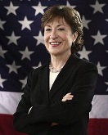
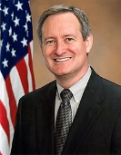
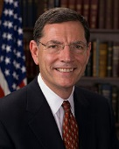
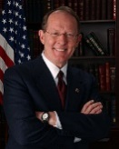
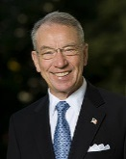
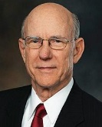
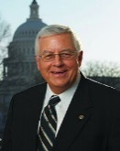
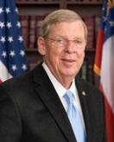
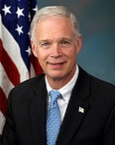
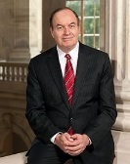
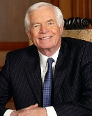
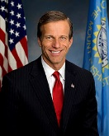
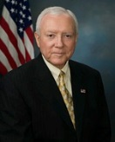
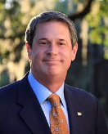
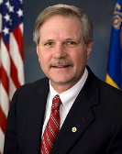
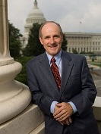
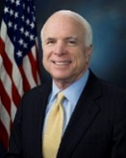
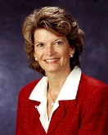
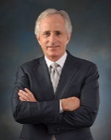
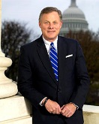
GOP chairmen assume new roles in Senate committees
SENATE CHAIRMEN
Senate committee chairmen in the 115th Congress
Banking, Housing, & Urban Affairs
Mike Crapo
(R-ID)
Replacing Richard Shelby (R-AL)
Environment and Public Works
John Barrasso
(R-WY)
Replacing Jim Inhofe (R-OK)
Aging
Susan Collins
(R-ME)
HELP
Lamar Alexander
(R-TN)
Judiciary
Chuck Grassley
(R-IA)
Rules and Administration
Richard Shelby
(R-AL)
Replacing Roy Blunt (R-MO)
Agriculture, Nutrition, & Forestry
Pat Roberts (R-KS)
Homeland Security & Gov’t Affairs
Ron Johnson (R-WI)
Budget
Mike Enzi
(R-WY)
Ethics
Johnny Isakson
(R-GA)
Small Business & Entrepreneurship
Jim Risch
(R-ID)
Replacing David Vitter (R-LA)
Appropriations
Thad Cochran
(R-MS)
Incumbent
Indian Affairs
John Hoven
(R-ND)
Replacing John Barrasso (R-WY)
Commerce, Science, & Trans John Thune
(R-SD)
Finance
Orrin Hatch
(R-UT)
Armed Services
John McCain
(R-AZ)
Incumbent
Energy and Natural Resources
Lisa Murkowski
(R-AK)
Foreign Relations
Bob Corker
(R-TN)
Intelligence
Richard Burr
(R-NC)
Veterans Affairs
Johnny Isakson
(R-GA)
January 11, 2017 | Francis Torres

